Slide 1
Loss Functions and Optimization Algorithms in
Neural Network

Slide 2
Optimization Algorithms and Loss Functions
The choice of Optimization Algorithms and Loss Functions for an ANN based learning model can play a big role in producing optimum and faster results.

Slide 3
Error and Loss Function:
In most learning networks, error is calculated as the difference between the actual output and the predicted output.
The function that is used to compute this error is known as Loss Function J(.).
Different loss functions will give different errors for the same prediction, and thus have a considerable effect on the performance of the model.
One of the most widely used loss function is mean square error, which calculates the square of difference between actual value and predicted value.
Different loss functions are used to deal with different type of tasks, i.e. regression and classification.

Slide 4
Loss Function:
Mean Squared Error
Binary Crossentropy
Categorical Crossentropy

Slide 5
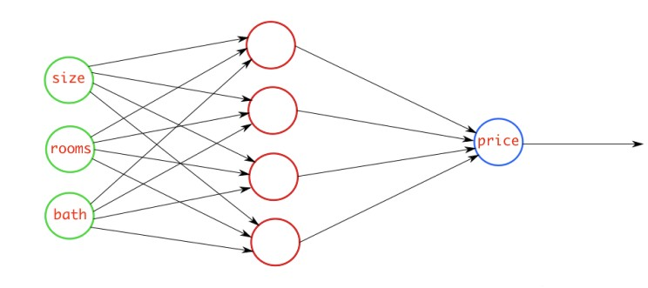
Mean Squared Error
This loss is calculated by taking the mean of squared differences between actual(target) and predicted values.
Example:
For Example, we have a neural network which takes house data and predicts house price. In this case, you can use the MSE loss. Basically, in the case where the output is a real number, you should use this loss function.

Slide 6
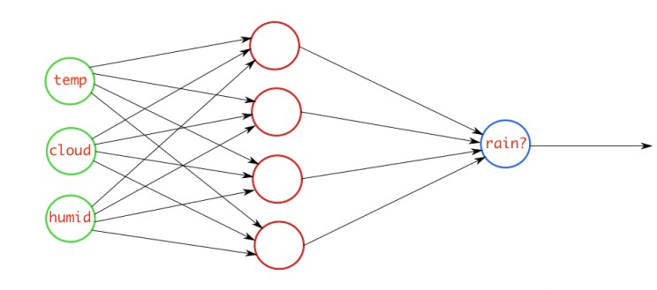
Binary Crossentropy
When we have a binary classification task, one of the loss function you can go ahead is this one. If you are using BCE loss function, you just need one output node to classify the data into two classes. The output value should be passed through a sigmoid activation function and the range of output is (0 – 1).
Example
For example, we have a neural network which takes atmosphere data and predicts whether it will rain or not. If the output is greater than 0.5, the network classifies it as rain and if the output is less than 0.5, the network classifies it as not rain.

Slide 7
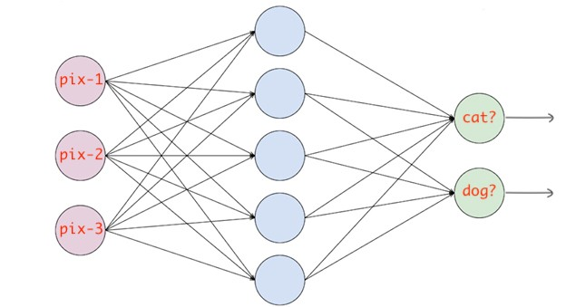
Categorical Crossentropy
When we have a multi-class classification task, one of the loss function you can go ahead is this one. If you are using CCE loss function, there must be the same number of output nodes as the classes. And the final layer output should be passed through a softmax activation so that each node output a probability value between (0–1).
Example:
For example, we have a neural network which takes an image and classifies it into a cat or dog. If cat node has high probability score then the image is classified into cat otherwise dog. Basically, whichever class node has the highest probability score, the image is classified into that class.

Slide 8
An overview of gradient descent optimization algorithms

Slide 9
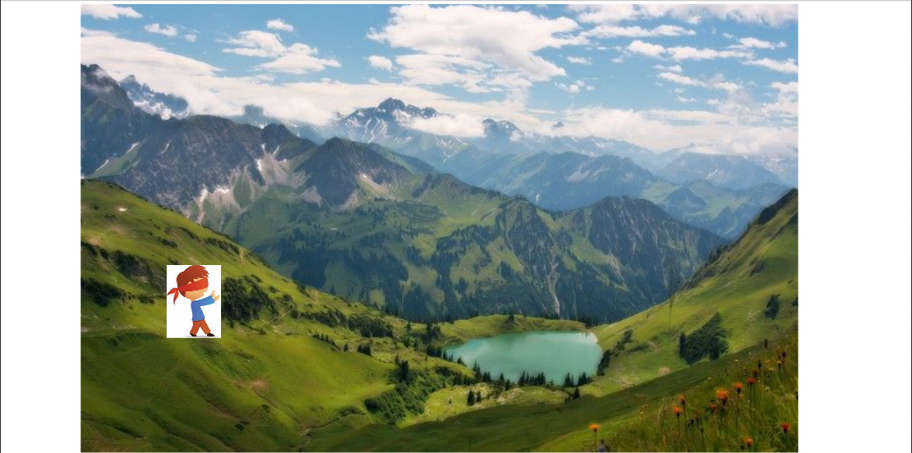
Gradient Descent
Notes:
Suppose you are at the top of a mountain, and you have to reach a lake which is at the lowest point of the mountain (a.k.a valley). A twist is that you are blindfolded and you have zero visibility to see where you are headed. So, what approach will you take to reach the lake?
The best way is to check the ground near you and observe where the land tends to descend. This will give an idea in what direction you should take your first step. If you follow the descending path, it is very likely you would reach the lake.

Slide 10
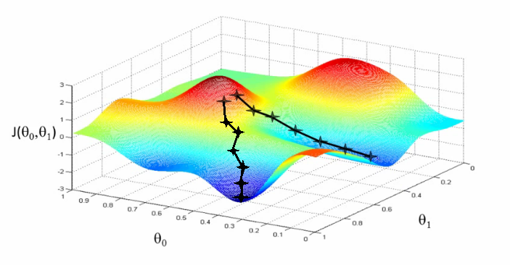
Gradient Descent
Notes:
Let us now map this scenario in mathematical terms.
Suppose we want to find out the best parameters (θ1) and (θ2) for our learning algorithm. Similar to the analogy above, we see we find similar mountains and valleys when we plot our “cost space”. Cost space is nothing but how our algorithm would perform when we choose a particular value for a parameter.
So on the y-axis, we have the cost J(θ) against our parameters θ1 and θ2 on x-axis and z-axis respectively. Here, hills are represented by red region, which have high cost, and valleys are represented by blue region, which have low cost.

Slide 11
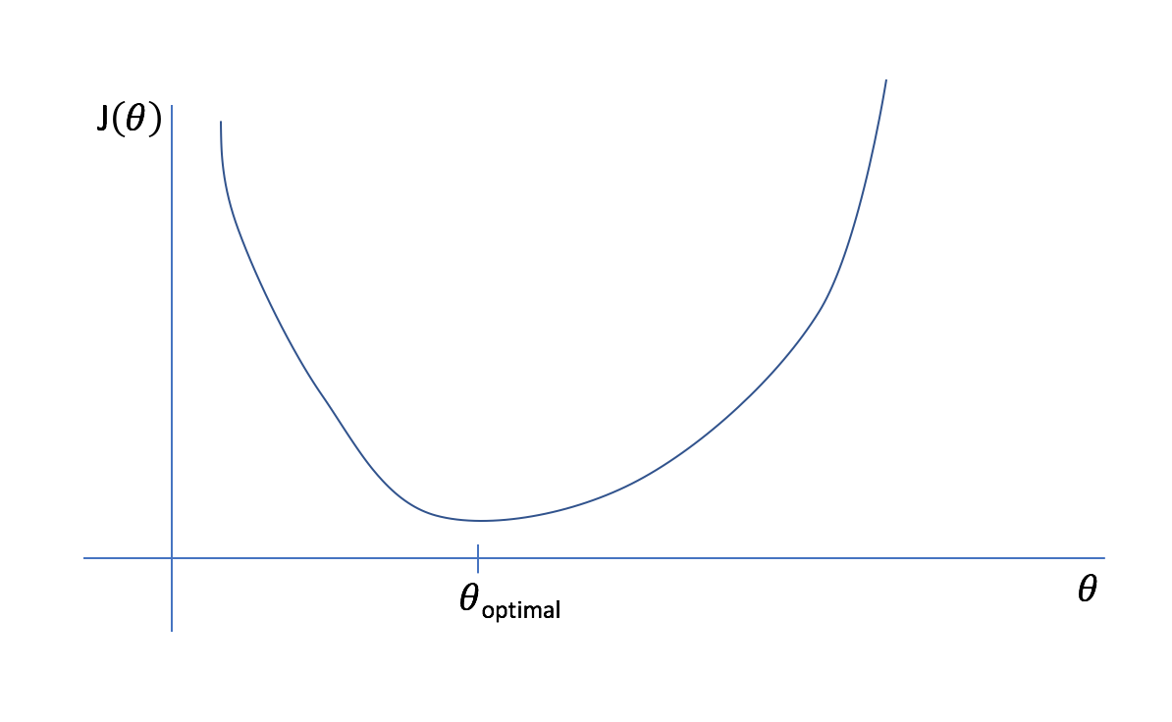

Slide 12
Gradient Descent
Gradient Descent is an optimization algorithm for finding a local minimum of a differentiable function. Gradient descent is simply used in machine learning to find the values of a function's parameters (coefficients) that minimize a cost function as far as possible.
Gradient descent is used when training a machine learning model. It's based on a convex function and adjusts its parameters iteratively to minimize a given function to its local minimum.
We start by defining the initial parameter's values and from there gradient descent uses calculus to iteratively adjust the values so they minimize the given cost-function.

Slide 13
What is a Gradient?
"A gradient measures how much the output of a function changes if you change the inputs a little bit." — Lex Fridman (MIT)
A gradient simply measures the change in all weights with regard to the change in error. You can also think of a gradient as the slope of a function. The higher the gradient, the steeper the slope and the faster a model can learn. But if the slope is zero, the model stops learning. In mathematical terms, a gradient is a partial derivative with respect to its inputs.

Slide 14
Variants of Gradient Descent algorithms
1. Batch Gradient Descent
Batch Gradient Descent, also called Vanilla Gradient Descent, is the simplest form of Gradient Descent. Its main feature is that we take small steps in the direction of the gradient. It basically calculates the error for each sample in the data and updates the model only after the training example has been calculated.

Slide 15
2. Stochastic Gradient Descent
Stochastic Gradient Descent (SGD) on the other hand, does this for each training example on the dataset, which means it updates the parameter for each training example one by one. This makes this one much faster than Vanilla Gradient Descent but quite computationally expensive. Expensive because the frequent updates take into account the noisy gradients as well which may cause the number of iterations to reach the minima longer.

Slide 16
3. Mini Batch Gradient Descent
As the name suggests, it is an amalgamation of both Vanilla Descent and SGD. Here, we take mini batches of a fixed size and then go on to update for each of the batches. This is the go-to method to reach minima efficiently. Therefore, it creates a balance between the robustness of stochastic gradient descent and the efficiency of batch gradient descent.

